Slide 1
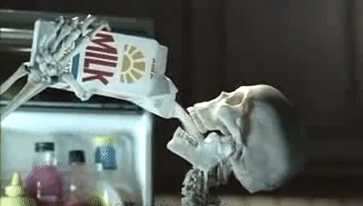
Mr Bones’ Unquenchable Thirst
“AAAAAAAAAAAAAAAAAAAAAAAAAAAAAHHHHH!!!!!” – Mr Bones
(Por Nebby)

Slide 2
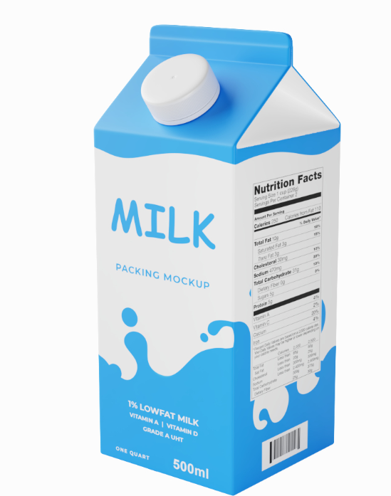
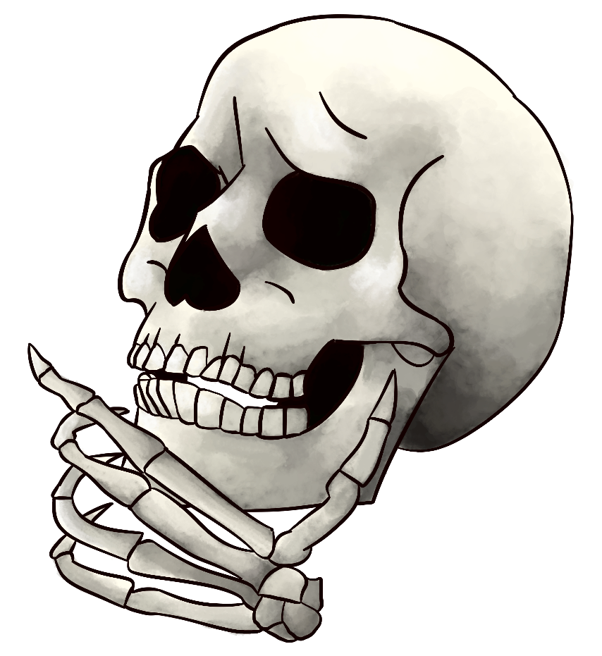
Story

Slide 3
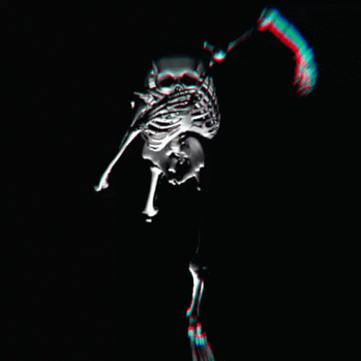
Objective
Wake up
Obtain Milk
(???)
Profit

Slide 4
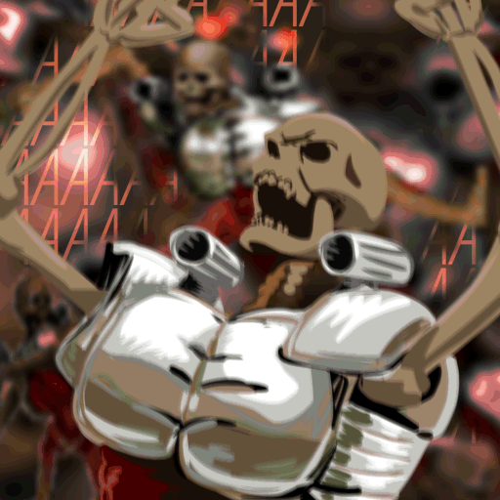
Mechanic
Agitate And SCREAM!

Slide 5
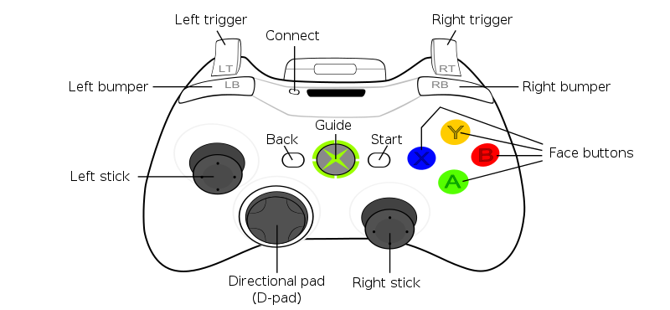
Controls
Input | Action
Left Stick | Move
Right Stick | Look/Aim
Left Bumper | Interact
Left Trigger | Agitate/Scream

Slide 6
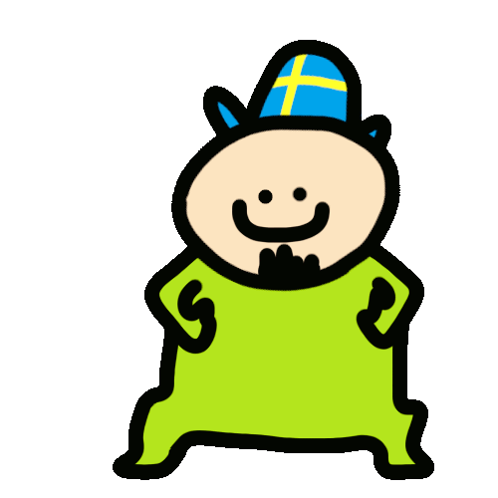
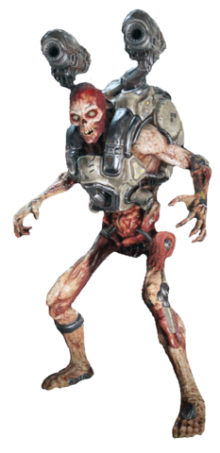
Skins
Spook (Normal
Viking (Joel Hat from Vinesauce)
Futuristic (Revenant Jetpack)

